Slide 1
URAL ENERGY INSTITUTE –
Territory of Collaboration
UrFU, Ural energy institute

Slide 2
Institute today
Institute was founded in 1930 and since that time was developed to meet challenges of energy industry and was transformed from one organizational structure to another
  Almost 75% of engineers and CEOs of largest energy enterprises in the Ural region – alumnus of Ural energy institute
Now we are one of the biggest institutes in Ural federal university:
  10 departments
  11 high-tech scientific and educational laboratories
  50 specialized utilities and testing rigs for scientific and educational purposes
  Professional staff: 60 professors, doctors of Sciences, 200 associate professors, candidates of Sciences, 30% of them – industrial experts
  2000 of students (engineering programs students – 150, bachelor’s programs, full-time and part-time students – 1700, master’s programs students – 150)

Slide 3
Leading R&D activities
N | Activity | Academic staff | Graduate students per year
1 | Modernization of electric power systems based on the modern innovations, advanced control algorithms and operation | 4 doct. of sci. 12 cand. of sci. | Bach. – 60 Masters – 20
2 | Creation new sources of energy, systems of renewable and nuclear energy with high efficiency | 3 doct. of sci. 8 cand. of sci. | Bach. – 15 Masters – 5 Engineers – 20
3 | Improving energy efficiency of industrial sector and public utilities | 6 doct. of sci. 9 cand. of sci. | Bach. – 50 Masters – 20
4 | Research and development in the field of low-grade solid fuel’s thermochemical conversion | 4 doct. of sci. 10 cand. of sci. | Bach. – 20 Masters – 5
5 | Research, development and supply of new types of energy-efficient electric motors | 2 doct. of sci. 7 cand. of sci. | Bach. – 60 Masters – 5
6 | Turbomachinery design for modern aero engines, energy and oil&gas industries | 5 doct. of sci. 12 cand. of sci. | Bach. – 60 Masters – 15

Slide 4
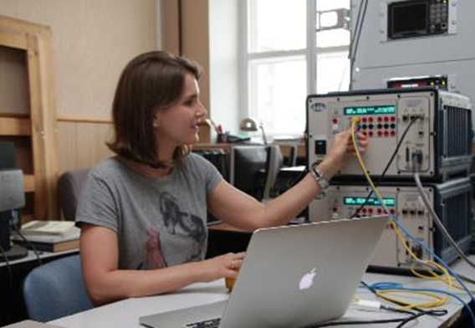
R&D activity N1
Modernization of electric power systems based on the modern innovations, advanced control algorithms and operation
Topics:
Determining optimal ratio of generating sources by type (renewable and non-renewable) for power supply schemes
Development of power supply schemes of enterprises and public utilities
Improving and control electric grid stability
Modelling and simulating transients processes in electric grid
Distributed generation of electric power
Reduction of losses in electric grid
Demand side management
Adaptation of algorithms to manage a high-voltage networks and distribution networks
Laboratories and testing rigs:
  Real-Time Digital Simulation system – digital modelling and testing of physical assets and complicated power distributed systems, DSM algorithms
  Laboratory of electrical assets of thermal power stations, laboratory of relay protection of electrical grid

Slide 5
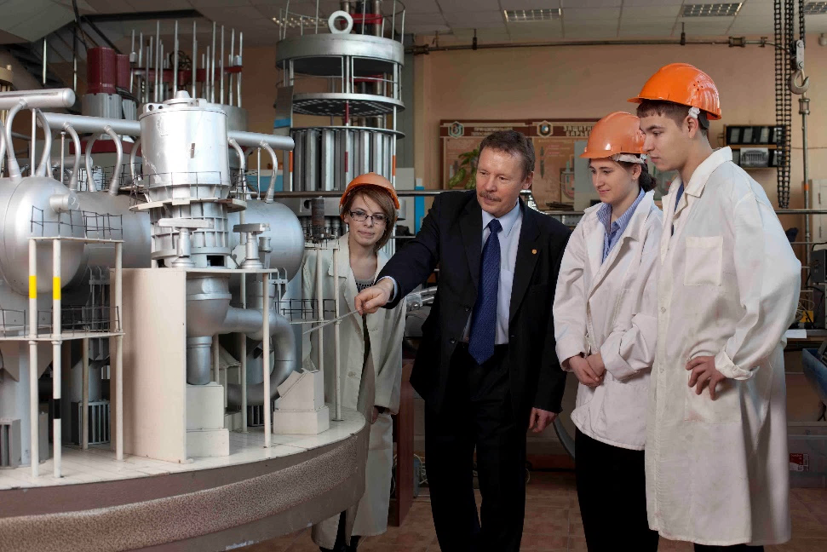
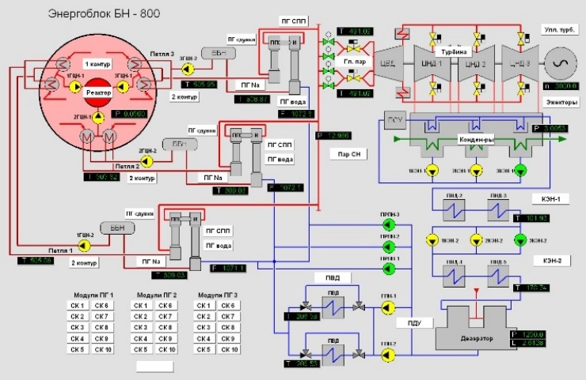
R&D activity N2
Creation new sources of energy, systems of renewable and nuclear energy with high efficiency
Topics :
Renewable energy for local supply (small hydro power stations, wind farms, PV)
Energy from agricultural residues (biogas)
Organic Rankine Cycle
Utilization of radioactive wastes
Efficient, affordable, reliable an safe nuclear energy
Laboratories and testing rigs:
  Nuclear power plant reactor segment
  Virtual simulator of emergency situations, allowing to simulate normal, transient and emergency modes of NPP
  Household with low energy consumption regime equipped by extended renewable energy system (wind, PV, heat pump)

Slide 6
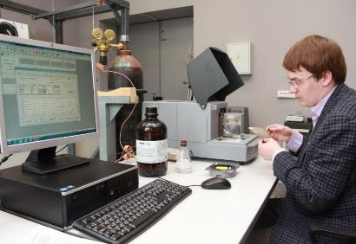
R&D activity N3
Improving energy efficiency of industrial sector and public utilities
Topics :
Both economic and technical issues of improving efficiency of complex engineering systems
Sustainable functioning of critical infrastructures
Management of engineering systems on Sustainable development basis
Development of this research area will create a unique approach for implementation energy and resource saving measures in the energy, industry and public utility sector, create a strategic and the methodological basis for putting into practice the concept of Sustainable Development
Laboratories and testing rigs:
  Laboratory of quality verification of heat-proof materials for housing and communal utility services
  Laboratory of heat and mass transfer
  Laboratory of water treatment
  SCADA laboratory (virtual modelling trainer) of automation of municipal boiler station equipped by small-scale steam turbine
  Municipal boiler station equipped by small-scale steam turbine

Slide 7
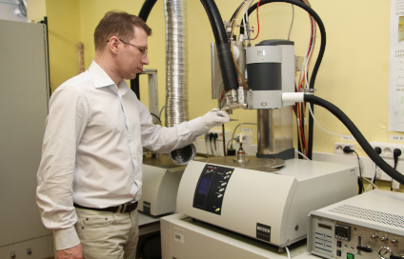
R&D activity N4
Research and development in the field of low-grade solid fuel’s thermochemical conversion
Laboratories and testing rigs:
  Synchronous Thermal Analysis TGA system
  Lab thermochemical reactors and steam gasifiers
  Laboratory of fuel combustion and research
  CFD-modelling laboratory
Practical results:
Cheap and reliable air-blown gasification technology for low-grade fuels with Net efficiency 44-45% and higher (more than 50%) in case of new gas turbines
Development of this research area will create highly efficient and environmentally friendly technologies for the production and use of synthesis gas and gases of metallurgical plants for production of electric and thermal energy

Slide 8
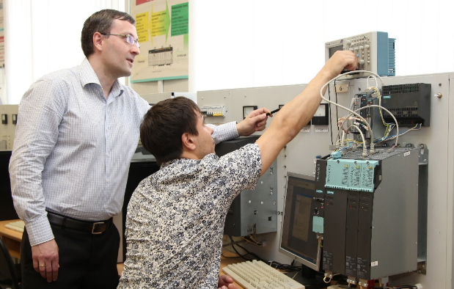
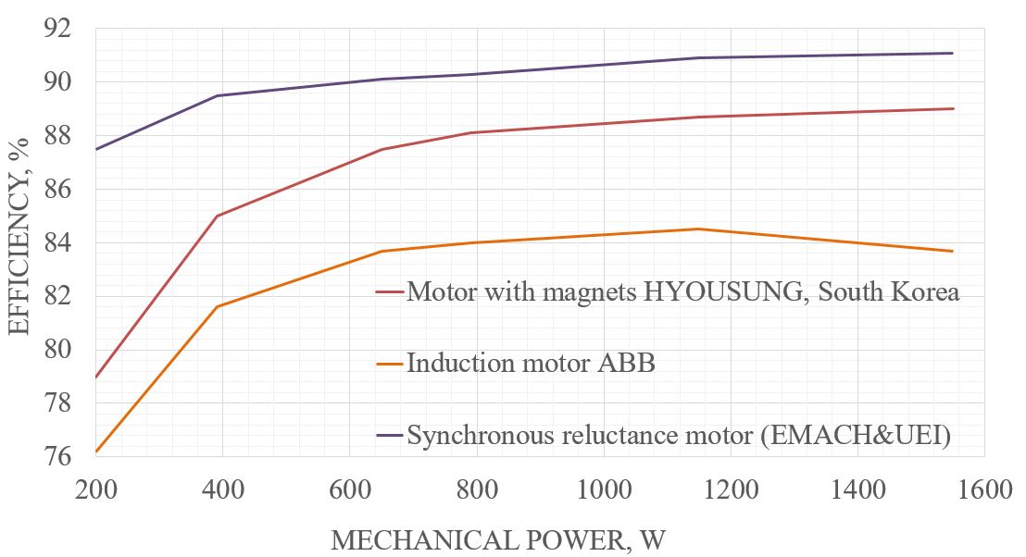
R&D activity N5
Research, development and supply of new types of energy-efficient electric motors
Practical results:
  new types of electric motors for the energy, transport, industry and for the special conditions of radioactive applications
  Energy-efficient magnet-free synchronous reluctance motor (SynRM) - efficiency class is IE4 and higher (IE5) according to new standard IEC 60034-30-2
  Recuperative systems with supercapacitors for transport and lifts
Laboratories and testing rigs:
  Laboratory of Electromechanics
  Laboratory of industrial electrical assets
  Laboratory of variable frequency drives

Slide 9
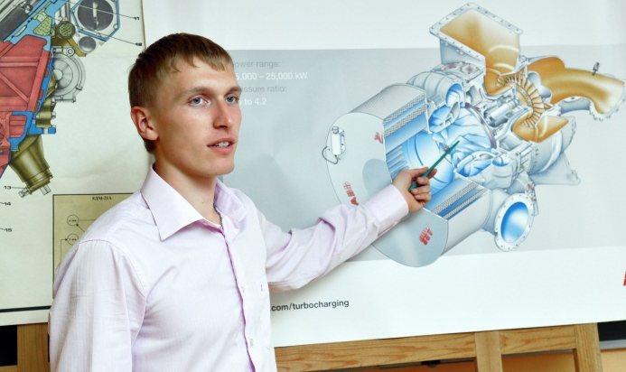
R&D activity N6
Turbomachinery design for modern aero engines, energy and oil&gas industries
Topics:
Mean line design and optimisation of axial and radial turbomachines,
In-house codes for flow path design and profiling. Well-developed optimisation algorithms
CFD modeling of the flow path and auxiliaries
Participation in new engines development as a design team or expert analysis
Technical support and expertise for industrial customers
Participation in industrial and research experiments all around Russia
Over 35 years experience and hundreds of successful implementation cases
Laboratories and testing rigs:
  Gas turbine laboratory with up to 180 parameters registration online
  Collaboration with leading industrial laboratories and certification centers allowing to perform various tests on different engine types

Slide 10
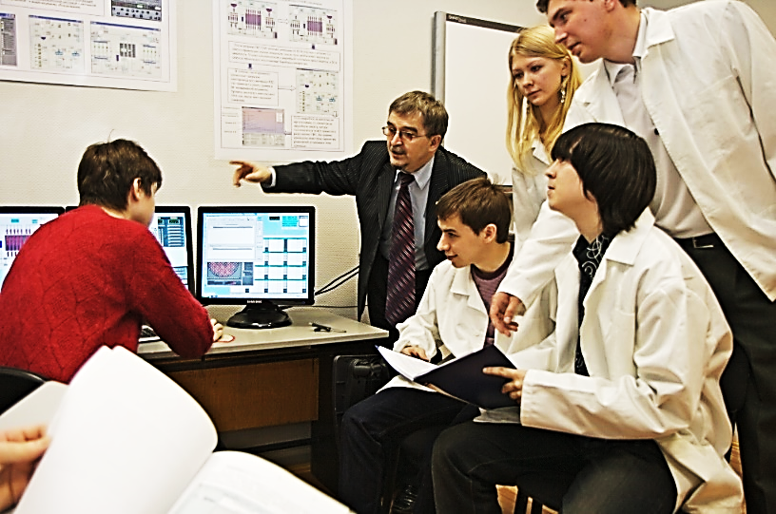
Bachelors & Engineers
Bachelors (4 years)
Heat engineering and thermotechnics
Power and electrical engineering
Renewable energy
Turbines and propulsions
Applied mathematics
Engineers (5.5 years)
Nuclear power plants: designing, exploitation, engineering
Active collaboration in educational field within "Energy” branch of Shanghai cooperation organization University
Cooperation with universities and organizations of Germany, Italy, Sweden, Poland, China, Mongolia, Kazakhstan, Vietnam, Tajikistan, Uzbekistan
Programs of double diplomas with Universities in Czech Republic and Egypt

Slide 11
Masters programs
2 years, full-time programs
Industrial heat engineering
Energy effective technologies of heat and power production
Alternative and renewable energy sources
Actual problems of technological process of production and transmission of electricity
Design and operation of electric power systems
Electrical power systems, networks, modes, stability, reliability
Fundamentals of electro mechanic
Electric drive and automation of industrial installations and technological complexes
Electrical equipment and automation of robotic systems
High voltage electrical equipment and installations
Electrotechnological installations with systems of power and control
Power supply and electrical equipment of industrial enterprises
Turbines and propulsions
Applied mathematics

Slide 12
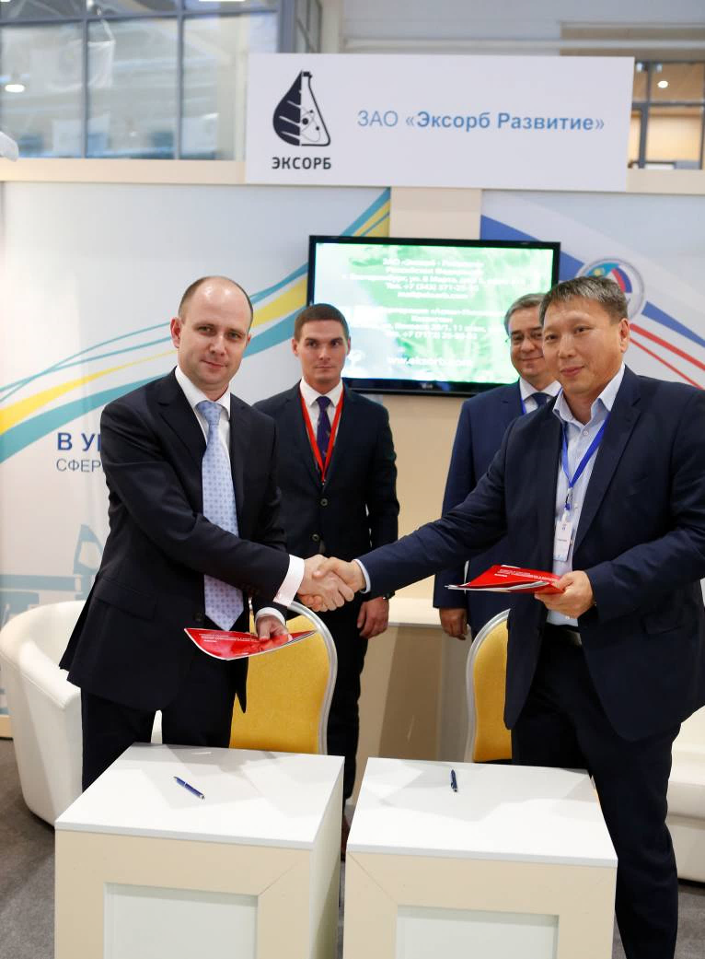
Ways of collaboration
Collaborative R&D
Training of students, undergraduates, graduate students, staff
Joint publication of articles, monographs
The creation of joint educational programs, electronic educational resources, implementation of joint training programs
Organization of joint conferences, exhibitions, meetings

Slide 13
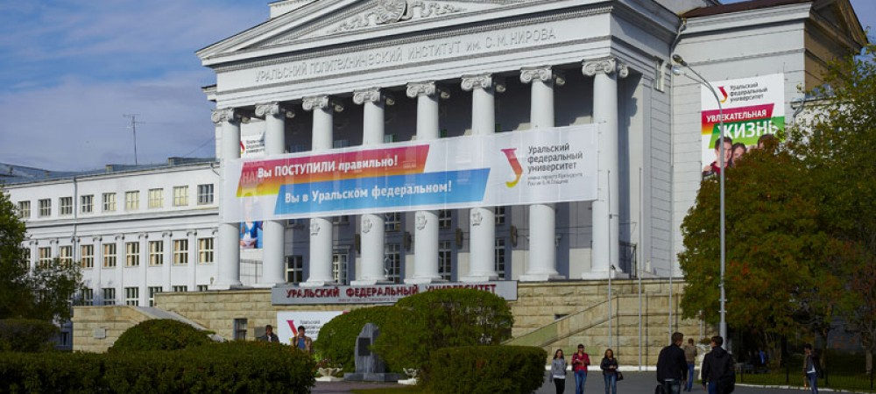
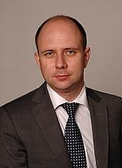
URAL ENERGY INSTITUTE
URAL ENERGY INSTITUTE
Ural Federal University
Sofia Kovalevskaya str., 5
620002, Ekaterinburg , Russia
Tel. +7 (343) 375-41-87
e-mail: enin@urfu.ru
www.enin.urfu.ru
Dr. Vadim Silin
International cooperation, contact person
Tel. +7 922-189-21-69
e-mail: v.e.silin@urfu.ru
Sergey Avdeev
International cooperation, Germany
Tel. +49 (0)163-214-11-48
e-mail: avdeev.sergey.gen@yandex.com
Prof. Dr. Sergei Sarapulov
Direktor

